Slide 1


CAPSTONE PROJECT DESIGN DOCUMENT
Post Graduation Certification in
Data Science
and
Machine Learning
Prediction of Covid-19 spread using Time series with LSTM
Rashmi Kale

Slide 2
Background
World Health Organization (WHO) and medical authorities all over the world are busy in taking appropriate measures against COVID-19. It is important to do proper planning and the success is dependent on the arrangements that will be made in near future to stop the spread of this disease. This project by prediction of upcoming cases will help the authorities to plan accordingly, i.e. to arrange appropriate number of medical facilities.

Slide 3
Dataset
For this project, we are using data repository for the 2019 Novel Coronavirus by the Johns Hopkins University Center for Systems Science and Engineering (JHU CSSE).
In our project, we are interested on the country level cases data. We would be taking the three different time series summary including confirmed, deaths and recovered covid cases across the world.
time_series_covid19_recovered_global.csv
time_series_covid19_deaths_global.csv
time_series_covid19_confirmed_global.csv

Slide 4
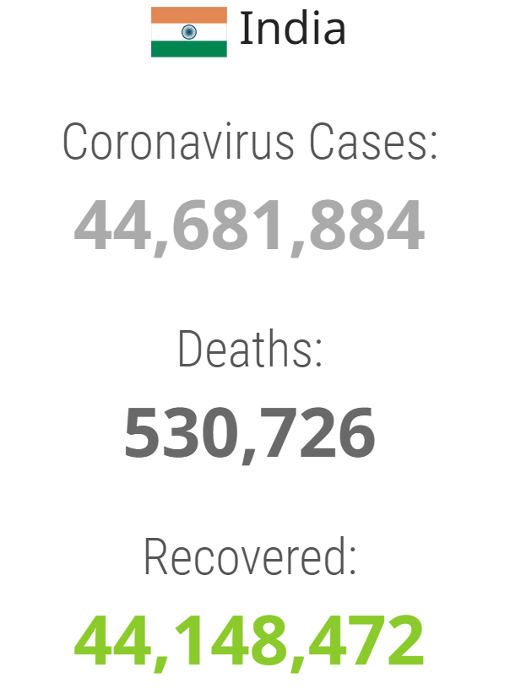
Problem Statement
Extract the times series records of confirmed, recovered and death related information for the country INDIA.
After preprocessing the raw data, build a LSTM model to predict the below:
Confirmed cases
Recovered cases
Death cases
Mortality Rate
Statistics for India
as on 17-Jan-2023
as per worldometers.info

Slide 5
Solution Model
Long Short-Term Memory (LSTM) networks are a type of recurrent neural network (RNN) capable of learning order dependence in sequence prediction problem.
We will be using LSTM to predict values for given timeseries
Fig: a typical LSTM cell

Slide 6
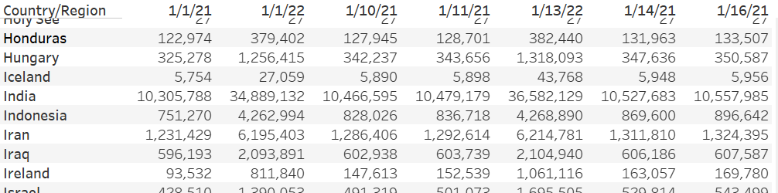
Design
1. Prepare Data
Filter: The data is in csv format and for all countries. Out of it we will first filter only the required data for country India.
Filter on Country/Region == India

Slide 7
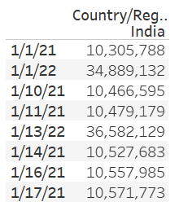
Design
1. Prepare Data
Transform: The data has countries as rows and dates as columns, we need date values as rows for a time series, so we need to take transpose of the dataset.
Rows to columns transformation

Slide 8
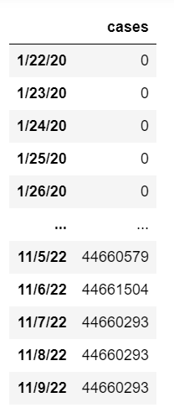
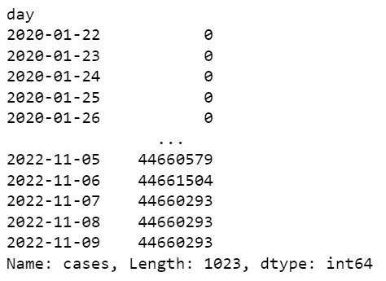
Design
1. Prepare Data
Timeseries conversion: To convert our DataFrame into a timeseries, we need to first convert the dates into a desirable format and then derive a timeseries out of it.
Date formatting and timeseries conversion

Slide 9
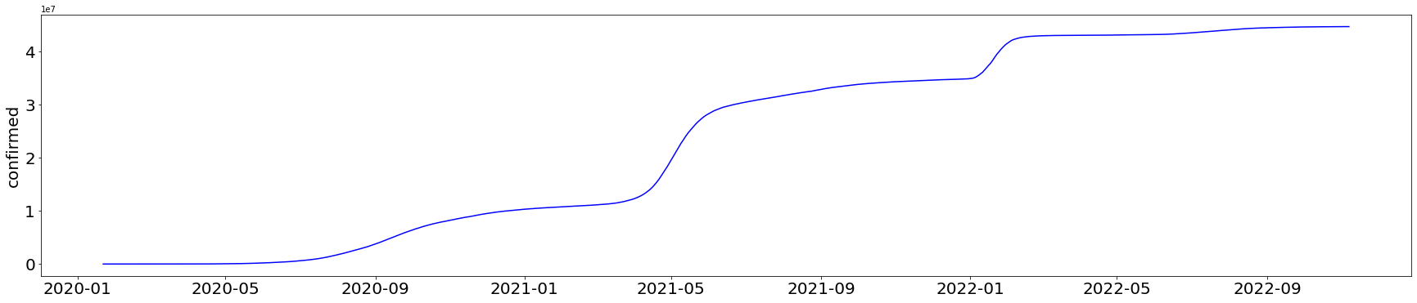
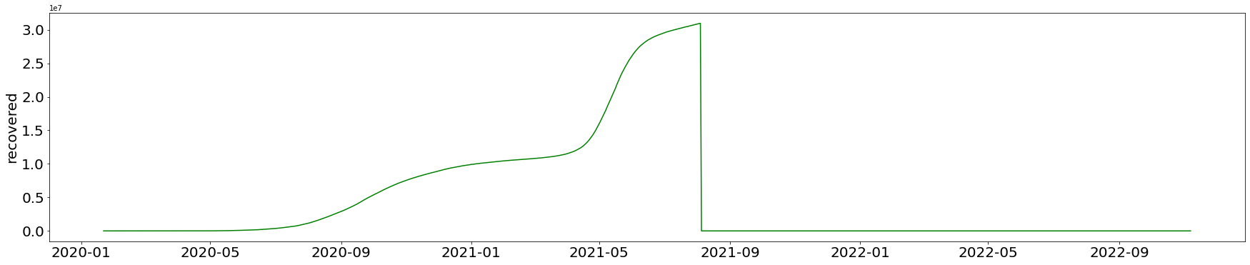
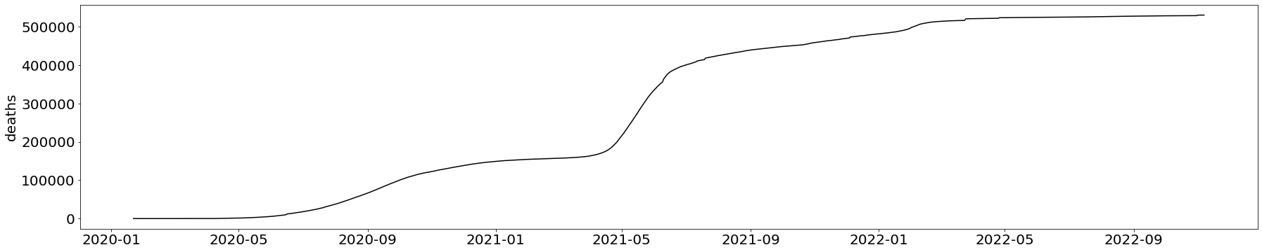
Design
2. Analyse Data
Plot time series: Once the data is prepared, we will be plotting a timeseries graph to visualize the progression of cases for confirmed, recovered and deaths.
Sudden drop suggesting the data has not been updated

Slide 10
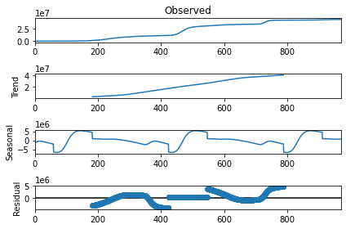
Design
3. Analyse Data
Decompose time series: After the data is plotted we will decompose all three times series into seasonal, trend and residual components.
Upward trend indicating that series is not stationary

Slide 11
Design
3. Analyse Data
Perform Test for Stationarity: The next thing to check is whether the given time series is stationary or not. To do so, we will perform the Augmented Dickey-Fuller(ADF) test.
A Dickey-Fuller test is a unit root test that tests the null hypothesis that the series is non-stationary .
Null Hypothesis (H0): series is not stationary
If p-value < 0.05 then we can reject the null hypothesis and establish that the series is stationary.

Slide 12
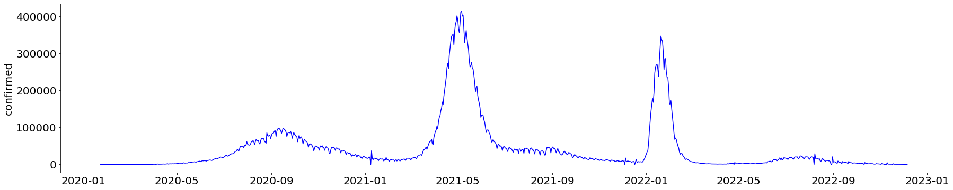
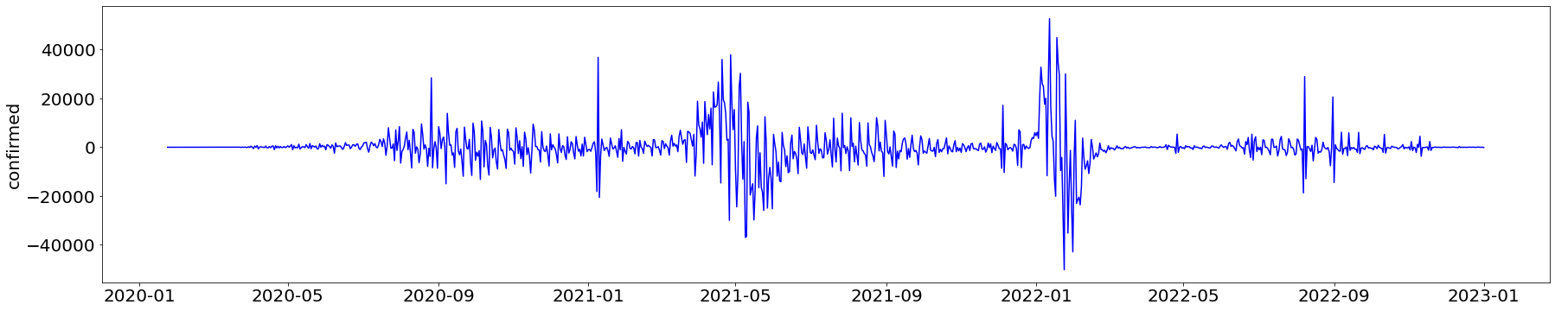
Design
4. Differencing the Time Series
Based on the result of ADF test we will take the difference of time series until we get a stationary series. We will try 1st order differencing and 2nd order differencing .
1st order differencing:
p-value = 0.029014
2nd order differencing:
p-value = 1.01690e-13
Over-differenced series

Slide 13
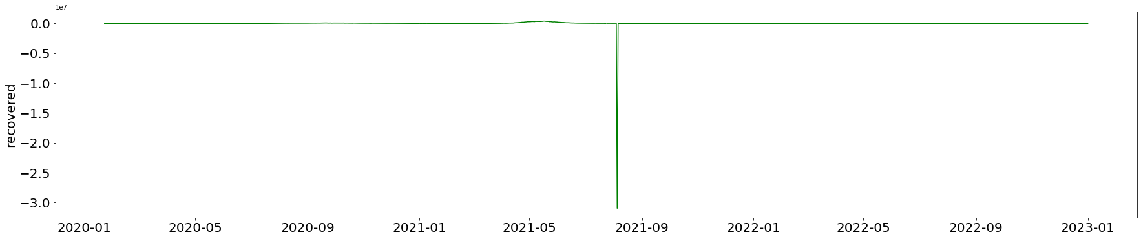
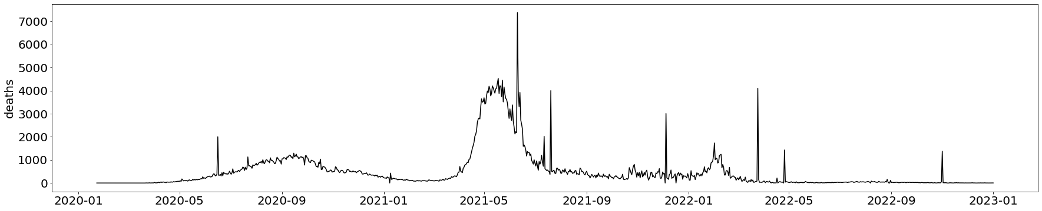
Design
4. Cleaning Data after Differencing
As 2nd order causes over-differencing so we will go with 1st order differencing. However after doing first order differencing there are some issues with recovered and deaths data
Recovered cases data is not updated after 4th Aug 2021
Too many sudden spikes in death records

Slide 14
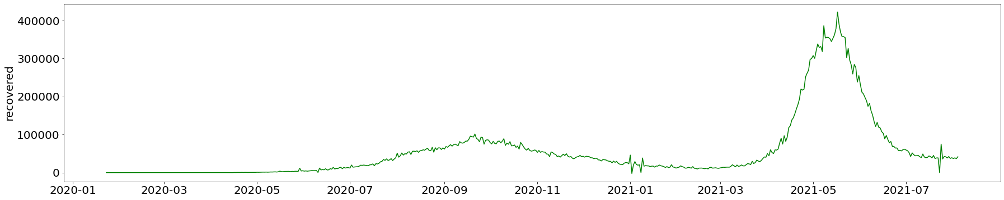
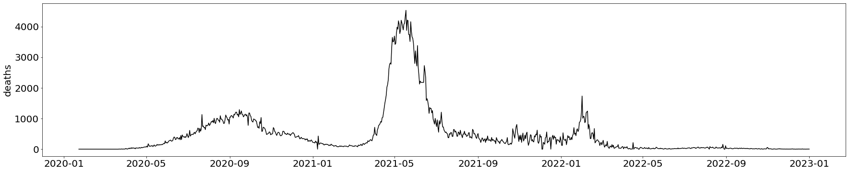
Design
4. Cleaning Data after Differencing
To overcome such discrepancies in data, we need to write customized methods and do the data formatting. After cleaning the data looks like this:

Slide 15
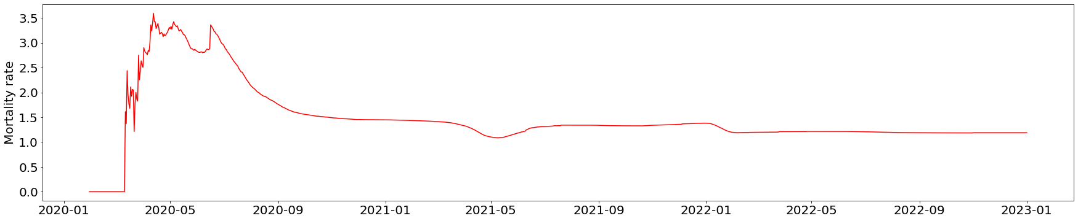
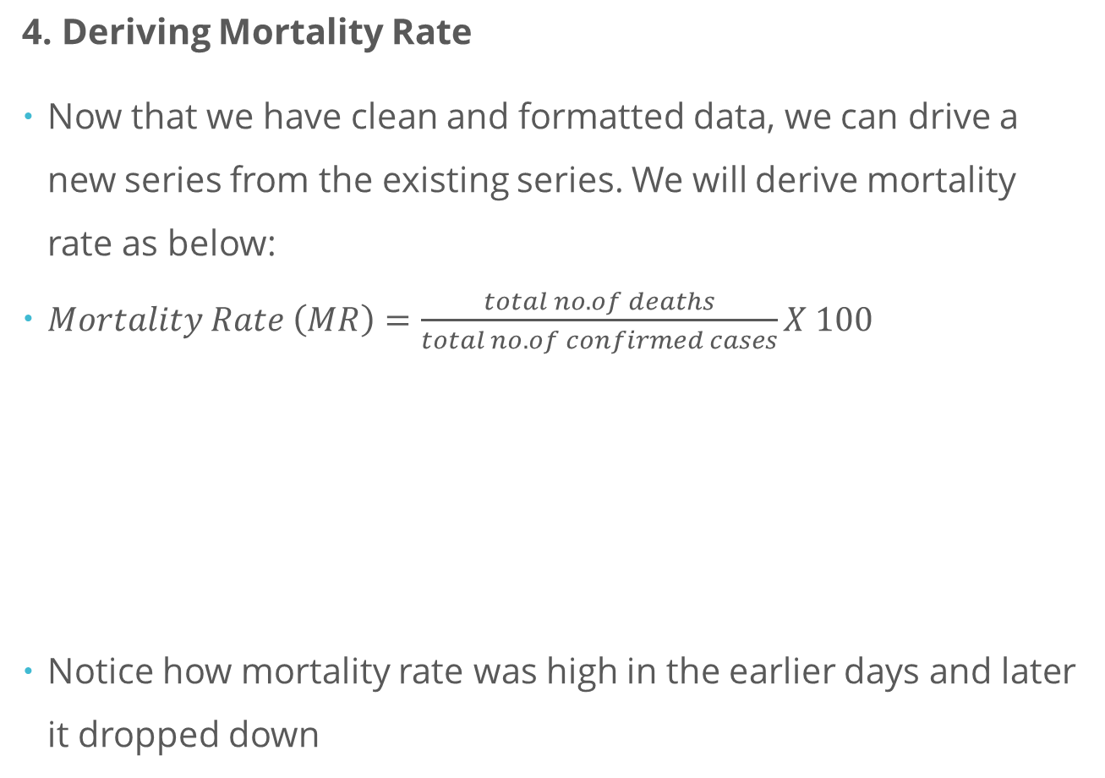
Design
4. Deriving Mortality Rate
Now that we have clean and formatted data, we can drive a new series from the existing series. We will derive mortality rate as below:
$Mortality Rate \left(MR\right)=\frac{total no. of deaths}{total no. of confirmed cases}X 100$
Notice how mortality rate was high in the earlier days and later it dropped down

Slide 16
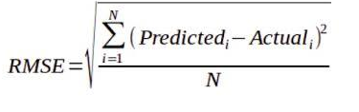
Evaluation Metrics
5. Defining metrics for evaluation:
We will be using multiple metrics to evaluate our models:
Root Mean Squared Error (RMSE): It calculates the root of mean of difference between actual and predicted values.
Although a good metric, the values of RMSE depend on the scale of data, so if the scale of data is different, then it becomes difficult to compare results.

Slide 17

Evaluation Metrics
Normalized Root Mean Squared Error (NRMSE): It normalises the RMSE as per the scale of data.
Here we are dividing by the mean of actual data to normalize the RMSE.
= mean of actual data

Slide 18


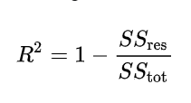
Evaluation Metrics
R2- Score: also known as coefficient of determination is the amount of the variation in the output dependent attribute which is predictable from the input independent variable(s)
The sum of squares of residuals:
The total sum of squares:
R2-Score:

Slide 19
Design
5. Benchmarking with ARIMA
To find benchmark, we will build ARIMA model for confirmed cases. ARIMA stands for Auto-Regressive Integrated Moving-Average.
The AR part of ARIMA indicates that the evolving variable of interest is regressed on its own lagged values.
The MA part indicates that the regression error is actually a linear combination of error terms whose values occurred contemporaneously and at various times in the past.
The I indicates that the data values have been replaced with the difference between their values and the previous values.

Slide 20
Design
5. Benchmarking with ARIMA
To build an ARIMA model we need 3 parameters, p, d and q.
p is the number of autoregressive terms.
d is the number of nonseasonal differences needed for stationarity
q is the number of lagged forecast errors in the prediction equation.
ŷ_{t} = μ + ϕ₁ y_{t-1} +…+ ϕ_{p} y_{t-p} - θ₁e_{t-1} -…- θ_{q}e_{t-q}
These values can be determined by looking at the acf and pacf plots as shown on next slide.

Slide 21
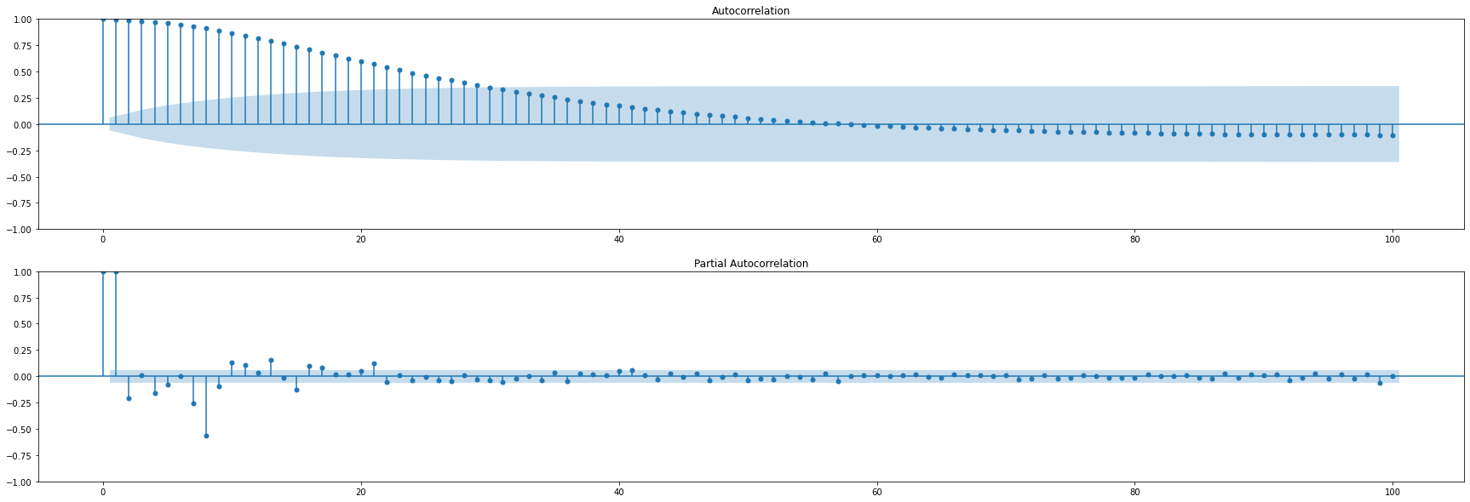
Design
5. Benchmarking with ARIMA
Auto correlation and Partial Auto correlation plots:
After looking at acf and pacf plots we decided to have p=2, q= 24 and d=0 as we are already dealing with differenced data.
MA value- q
AR value- p

Slide 22
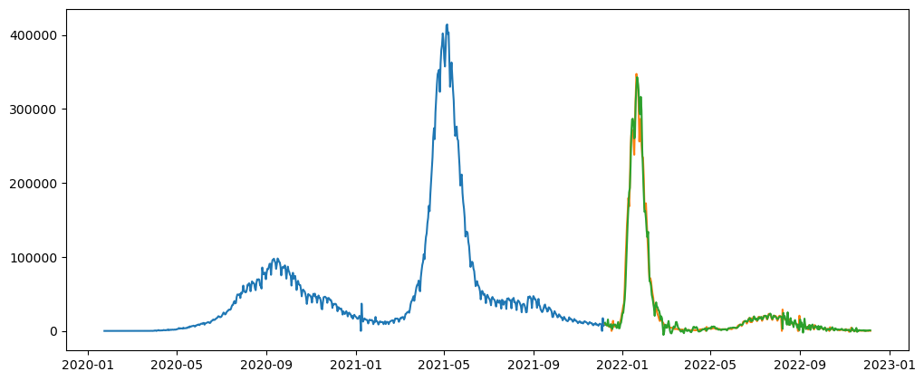
Design
6. Benchmarking with ARIMA
Results:
Train R2-score: 0.9959289937267725
Train RMSE: 4887.3623
Test R2-score: 0.9876847529274698
Test RMSE: 7262.3245

Slide 23
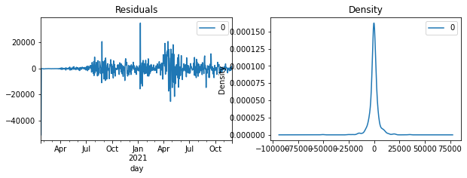
Design
6. Benchmarking with ARIMA
Inference: We can see that the RMSE value for training set is small, but for test set it is very high, this implies that the ARIMA model is overfitting the values. Another way to evaluate ARIMA model is to look at the residual plot:
The residual errors seem fine with near zero mean and uniform variance

Slide 24
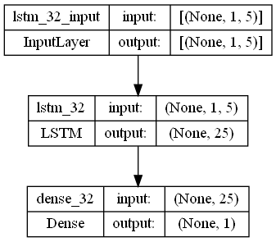
Model
7. Build LSTM model
Now we build the LSTM model. We will be building 3 separate models for Confirmed, Recovered and Death cases. We will be using single hidden layer to start with:
Input layer
Hidden layer
Output layer

Slide 25
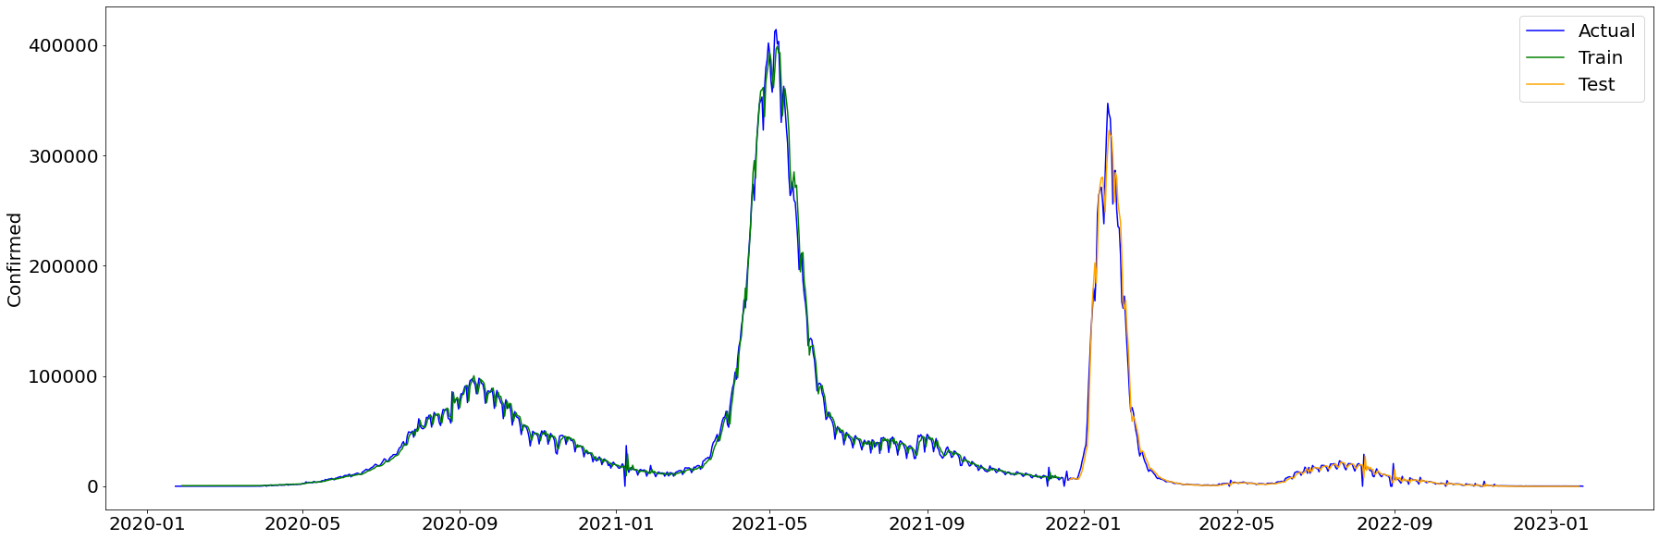
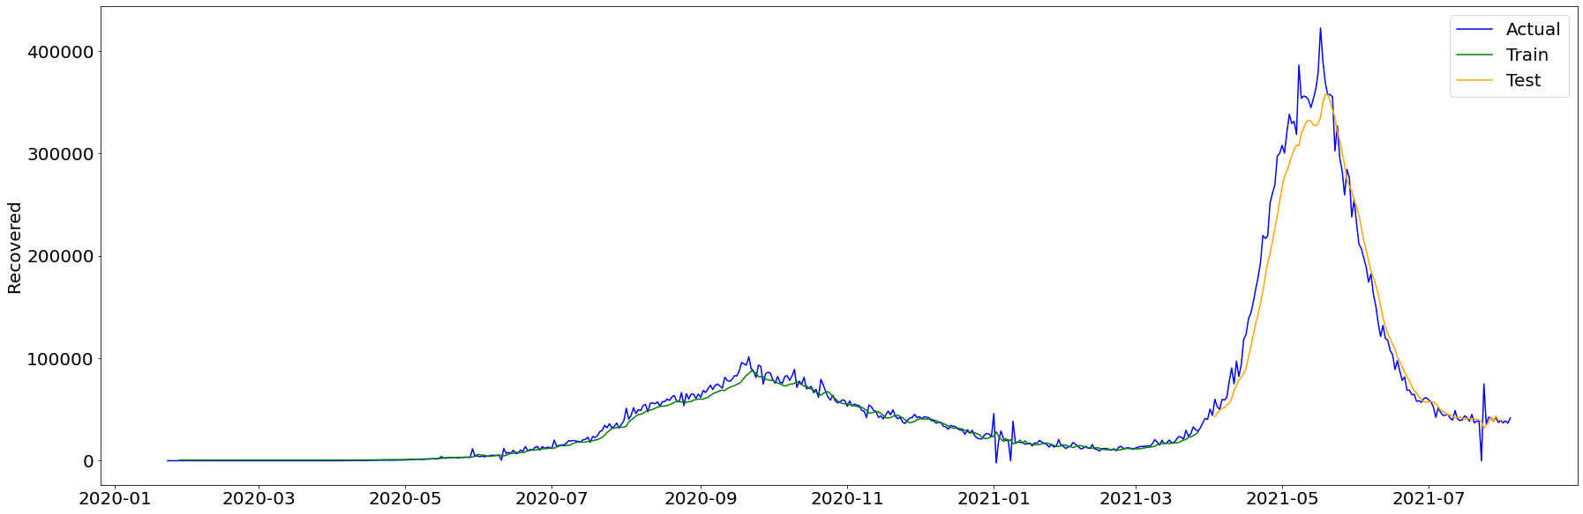
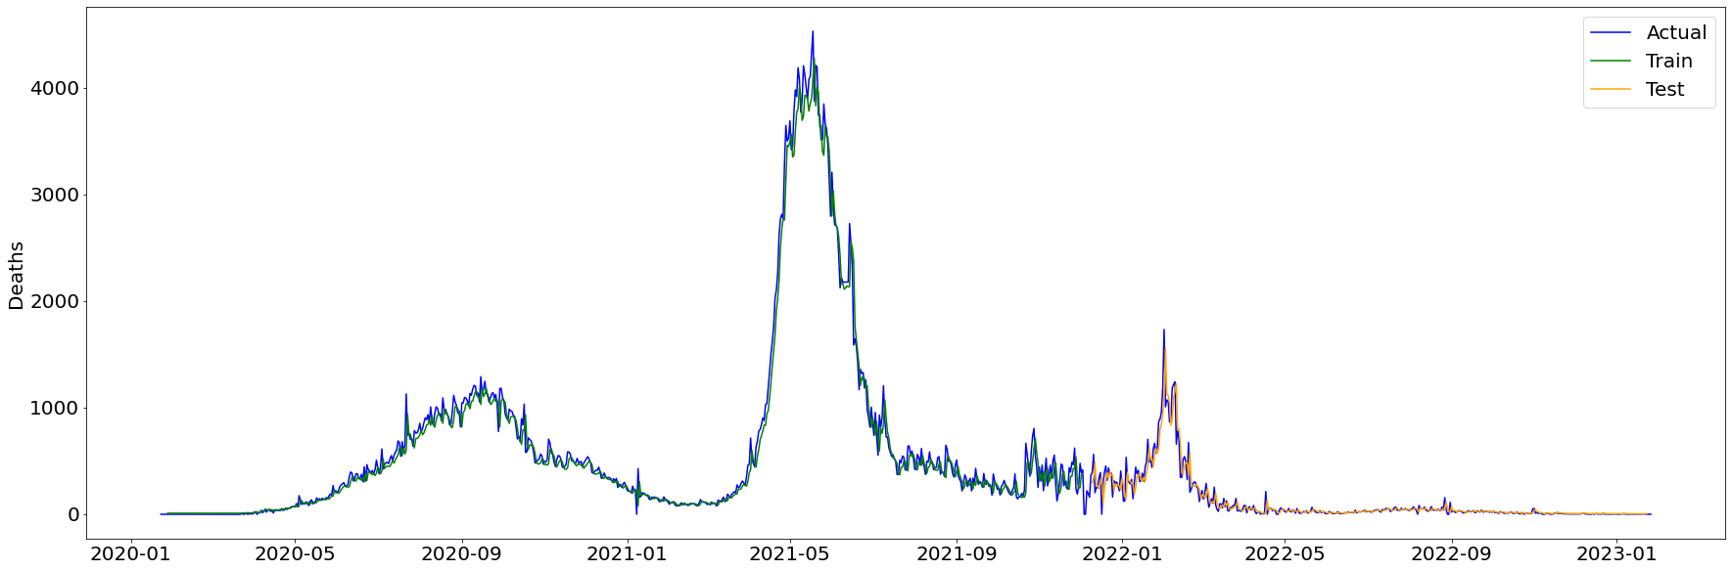
Model
8. Predict
Once models are built we will predict the values for the train as well as test datasets. Here are graphs showing predictions:

Slide 26
Model
9. Hyper parameter tuning
To tune our model, we will consider following parameters:
1. Scaling: As neural network models are sensitive to numeric values, it is important to normalize the data before sending it to model. We can use StandardScaler or MinMaxScaler for this purpose.
Important: Training and Test data must be scaled separately
2. Batch size: Batch size divides the underlying data into batches, in this case however keeping batch size as 1 has given the best result so far.

Slide 27
Model
9. Hyper parameter tuning
3. Look back interval(lag) : A “lookback period” defines how many previous timesteps are used in order to predict the subsequent timestep. In this case a lookback of 5 has shown better results. So values from the last 5 days will be used to predict the value for 6th day.
4. Number of Units: The number of units should be a multiple of the lookback window for better results. If lookback interval is 5, no. of units can be 5, 10 ,15, 20 etc.

Slide 28
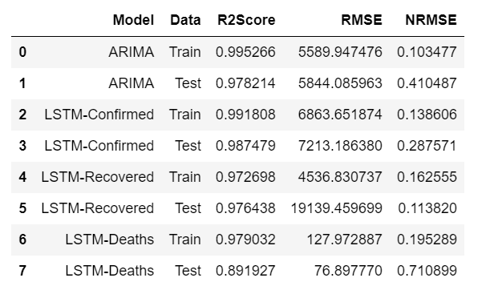
Model
8. Evaluate
Now we need to evaluate the accuracy of our prediction. For this we will be using the metrics that we have captured. Here is a comparison of the evaluation metrics for various models:

Slide 29
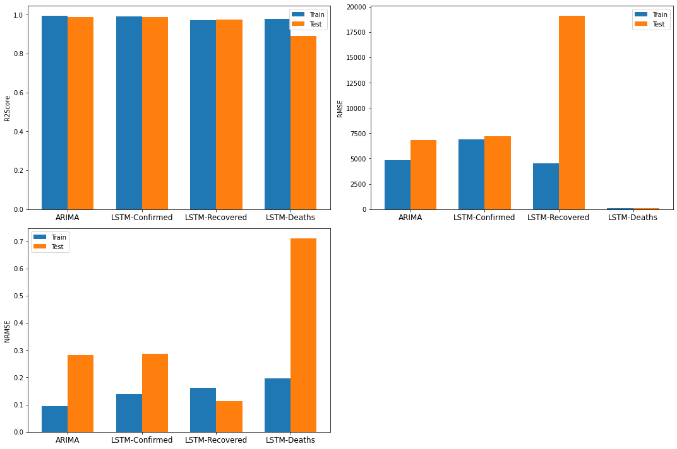
Model
8. Evaluate
Comparison of metrics for various models:
We can see that the results for confirmed cases and recovered cases look good but for death cases it is not so good. So there is scope for improvement

Slide 30
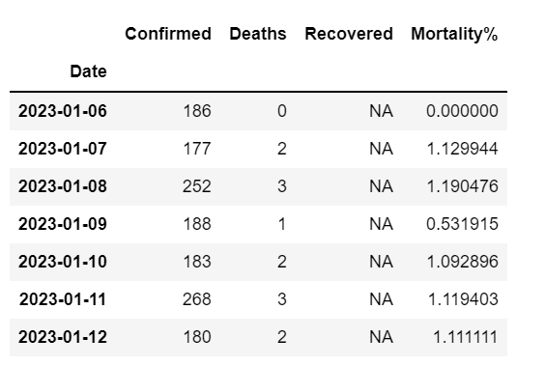
Results
10. Make forecast for future dates
These are the values predicted by the models for next 7 days, as of 6-Jan-2023. We are not predicting the recovered cases as the data for recovered cases has not been updated for a long time.

Slide 31
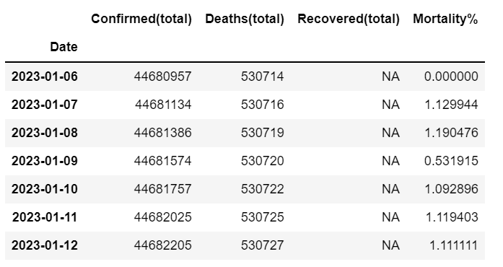
Results
10. Make forecast for future dates - cumulative
As the original data was in cumulative form the output can also me made cumulative. Here are the results for the total number of confirmed, recovered and death cases:

Slide 32
Improvement
11. Scope for improvement
We have used the basic version of LSTM for our models however following things can be considered:
Number of hidden layers: We can increase the number of hidden layers.
Dropout: We can add a dropout layer.
Early stopping: We can reduce the number of epochs and avoid overfitting

Slide 33
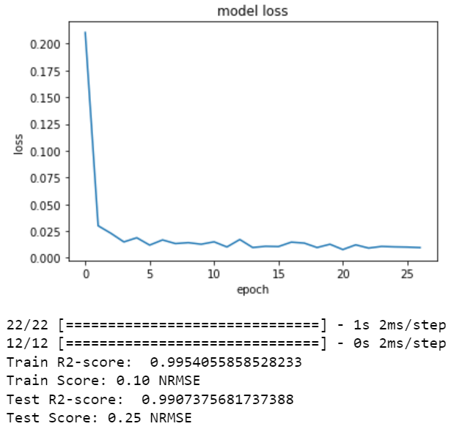
Improvement
11. Scope for improvement
After considering above points a new model was prepared for confirmed cases and a slight improvement was observed in the results:
params = {
"units" : 32,
"layers" : 2,
"dropout" : 0.1,
"loss" : "mean_squared_error",
"optimizer" : "adam",
"activation" : "linear",
"epocs" : 27,
"batchsize" : 1
}

Slide 34
Improvement
12. Making code modular
Currently we have designed the project in Jupyter notebook, however to deploy it, we need to make it modular. Here is a schema of how the code can be modularized:
Main.py
DataImport.py
DataPreprocessing.py
ARIMA.py
LSTM.py
LSTMImproved.py
Evaluation.py

Slide 35
Improvement
12. Conclusion:
In this project we have used 2 different modeling techniques for timeseries prediction. While ARIMA is also a good model for timeseries prediction for a smaller dataset like this one, it tends to overfit the data and there are less ways to optimize the model. LSTM on the other hand is more robust and can be optimized in many ways.
Before building the models, it is important that the timeseries is stationary. It is also important to scale the data before fitting the models. The metrics also need to be normalized due to large variation in the data scale. Currently we have used the entire data for country India. Going ahead the code can be modularized and generalized to predict values for any country and from any time period.

Slide 36
References
13. References
https://colah.github.io/posts/2015-08-Understanding-LSTMs/
https://towardsdatascience.com/time-series-forecast-error-metrics-you-should-know-cc88b8c67f27
https://support.ptc.com/help/thingworx_hc/thingworx_analytics_8/index.html#page/analytics/time_series_predictions.html
https://towardsdatascience.com/interpreting-acf-and-pacf-plots-for-time-series-forecasting-af0d6db4061c
https://www.machinelearningplus.com/time-series/arima-model-time-series-forecasting-python/
https://machinelearningmastery.com/use-dropout-lstm-networks-time-series-forecasting/
https://www.sciencedirect.com/science/article/pii/S2352914821000563

